Slide 1
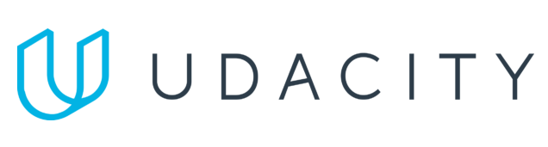
Data Lake Value Proposition
Medical Data Processing Company
Vu Ngo
Udacity IPS Version 1.0

Slide 2
Agenda
What is a Data Lake
Components of a Data Lake
Data Lake vs Data Warehouse
Business Value of Data Lake Solution
Proposed Data Lake Architecture for Medical Data Processing system
Udacity IPS Ver. 1 2/2020

Slide 3
What is a Data Lake
Executive summary
A data lake is a centralized repository that allows businesses to store and manage vast amounts of structured, semi-structured, and unstructured data in its native format. It enables businesses to break down data silos and access data from across the organization to generate insights, improve decision-making, and drive innovation. The flexibility and scalability of a data lake allow businesses to adapt to changing data needs and explore new data-driven opportunities.

Slide 4
Components of Data Lake
In high level, the 4 components of a data lake are:
Ingestion Layer: This component is responsible for the acquisition and ingestion of raw data into the data lake. It typically involves processes and tools for collecting, validating, transforming, and loading data from a variety of sources.
Storage Layer: This component is responsible for storing the data in its native format and making it available for processing and analysis. It typically involves a scalable and cost-effective storage solution such as cloud object storage.
Processing Layer: This component is responsible for processing the data stored in the data lake to generate insights and value. It typically involves tools and technologies for data processing, transformation, and analysis such as Hadoop, Spark, and machine learning frameworks.
Serving Layer: This component is responsible for serve people need to work with data (for example data analyst)

Slide 5
Data Lake vs Data Warehouse
A Data Lake solution is preferred over a Data Warehouse approach for Medical Data Processing Companies due to
The heterogeneous and unstructured nature of medical data.
A Data Lake can store raw data in its native format and allows for greater flexibility in processing and analysis.
It is also more cost-effective, scalable and efficient in managing the increasing volume and variety of medical data.

Slide 6
Data Warehouse
Data Lake
Data Warehouse typically requires structured data and a predefined schema.
High cost
Data Warehouses have limited scalability because DWH are designed to store structured data only.
Users: Business analysts, data scientists, and data developers
Can store raw and unstructured data in its native format
A Data Lake is typically more cost-effective than a Data Warehouse due to its ability to store vast amounts of data in a more scalable and cost-efficient way.
Data Lakes are highly scalable because can store vast amounts of raw and unstructured data
Users: Business analysts (using curated data), data scientists, data developers, data engineers, and data architects
Udacity IPS Ver. 1 2/2020

Slide 7
Business Value of Data Lake
A Data Lake can provide significant business value by improving system uptime, reducing latency of queries and reports.
Enabling fault tolerance and scalability, improving business agility through automation and experimentation.
Providing centralized storage and easy access to enterprise data.
Real time analysis: it help management team easy to keep track what going on.

Slide 8
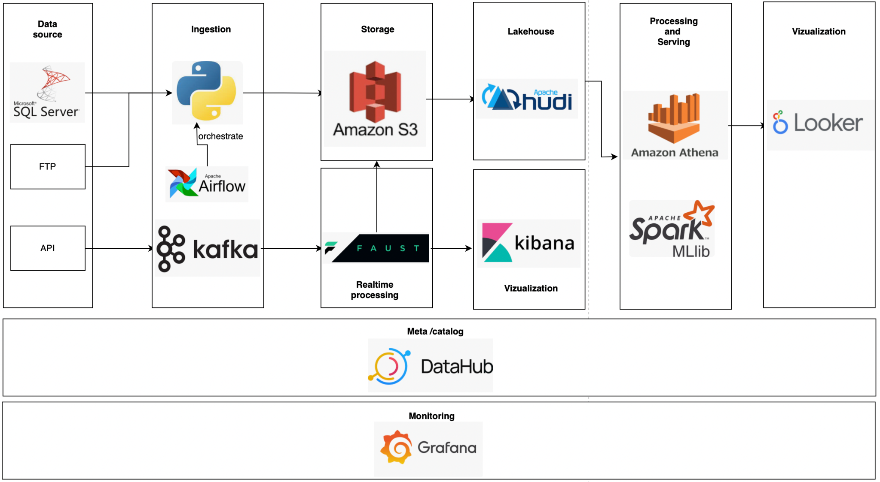
Data Lake Architecture

Slide 9
THANK YOU
Udacity IPS Version 1.0

